Slide 1
True Smart Gadgets
TS- WEB TRACK CAPSTONE PROJECT
Presented By:
1.Varagani Mounika– RGUKT Srikakulam (B.Tech CSE)
2.Velaga SNLL Prasanna-RGUKT Srikakulam (B.Tech CSE)
3.Nagireddy Sujitha-RGUKT Srikakulam (B.Tech CSE)
4.Yadla Usha Sri-RGUKT Srikakulam (B.Tech CSE)
Guided By: Uma Maheswari Madam

Slide 2
Abstract
As we know, technology growth is sprinting like a marathon, most people depend on electronic gadgets like smartphones, laptops, smart tv, and many more. But choosing the best product would be challenging as you can see every day a vast number of devices are being introduced in the market with many trending specifications. So, it can be difficult for most people to keep up with the change. But, now we aim to make this an easy task through this project. We will collect the data from various brands and rate them according to their specifications and prices. So, this will become a dataset of devices. We want to develop a website that will take input as requirements of the user for a particular kind of device and suggest to the user a few best products that suit their requirements with the help of our dataset. Thus, through this project, we hope to make the challenging task of buying the best product for a typical person as an easy task.

Slide 3
Problem Statement
As we know, technology is evaluating in a rapid pace. Most people depend on electronic devices like mobile, laptops, smart tv, and many more. But choosing a best product would be challenging as you can see with lot of device are being introduced everyday in the market, a common man could find it hard to keep up with these changes.

Slide 4
Proposed Solution
By implementing our proposed system, the user doesn’t need to specify the specifications directly, instead they can provide the purpose of the device, usage capacity, price range, specifications ( if any ).
By taking these input from the user, our model will analyze what kind of specifications user needs to have and collect the data from dataset which matches those specifications and provide those results to the user.
Through this extra added feature of analyzing specifications through model itself will make our platform more user friendly and can be useful to all kinds of users.

Slide 5
System Deployment Approach
In this proposed System, the technologies we have used are HTML, CSS, ReactJs.

Slide 6
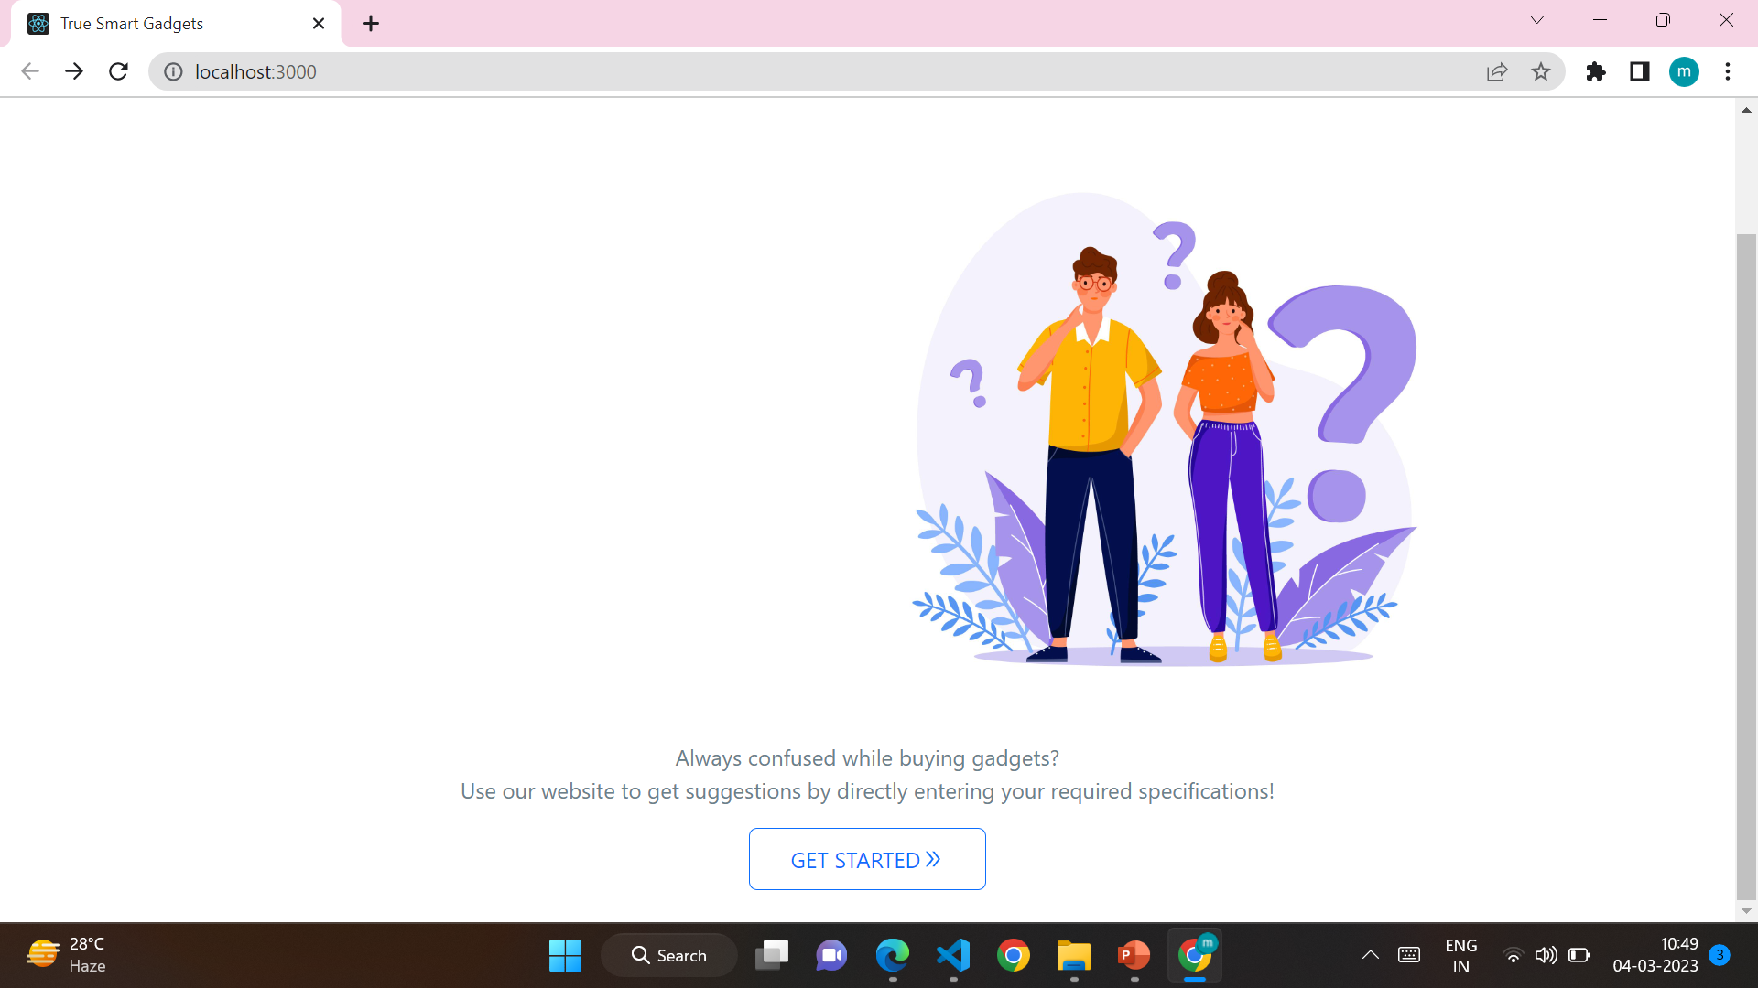

Slide 7
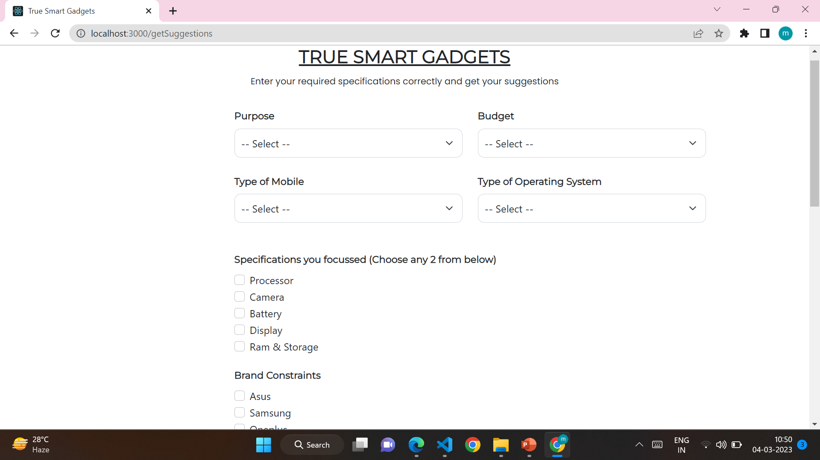

Slide 8
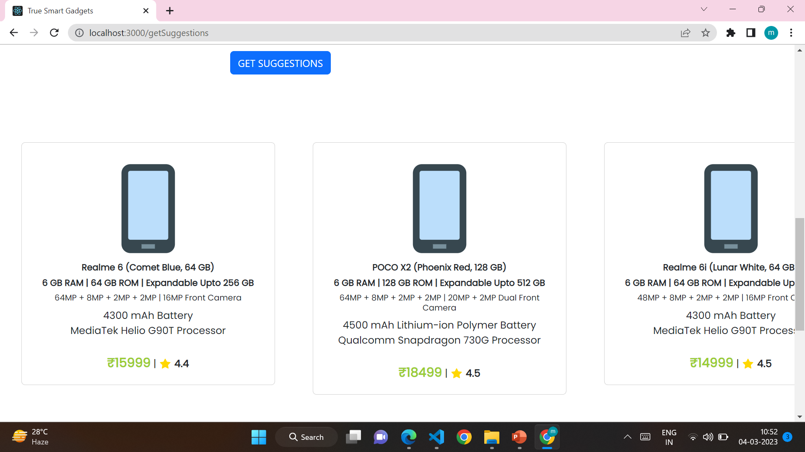

Slide 9
Conclusion
This project “TRUE SMART GADGETS “, a gadget recommendation system was successfully executed by our team to check the end results using own database and it is found that our proposed system provides efficient and effective result when compared to existing system. Our System provides the facilities as mentioned like product recommendations , it can be accessed as a web application and saves time, resources as well.

Slide 10
Future Scope
With an aim to make the task of buying a best smartphone for a common man easier and want to eliminate the dilemma of so many people while choosing a smart gadget, we developed a convenient and user-friendly web application using Reactjs. We also collected a dataset to provide the results for users, but due to limited resources, we are only able to collect the data for mobiles only, it can be further extended to other category of devices like laptops, smart tv etc; and also we are only able to produce the results which are matching the specifications from dataset, it can be further extended using a proper algorithm to identify a pattern to produce more helpful results.

Slide 11
THANK YOU

